Slide 1

NutriClass– Food Classification Using Nutritional Data
End-to-End Machine Learning Project

Slide 2

Project Overview
01
02
Classification Goal
Development Environment
Classified food items into distinct categories using comprehensive nutritional data including Calories, Protein, Carbohydrates, Fat, and Sugar content.
Complete end-to-end workflow implemented in Google Colab, ensuring reproducibility and accessibility for collaborative development.
03
04
Complete Pipeline
Performance Achievement
Comprehensive workflow covering Data Preprocessing, Exploratory Data Analysis, Model Training, and rigorous Evaluation.
Achieved remarkably high accuracy using sophisticated Machine Learning algorithms with balanced performance metrics.

Slide 3
Tech Stack Used
Languages & Libraries
Python
Core programming language for data processing and model development
Data Processing
Tools & Techniques
Pandas and NumPy for efficient data manipulation
Google Colab: Cloud-based development
environment
ML Frameworks
Scikit-learn and XGBoost for model building
SMOTE: Synthetic Minority Over-sampling Technique
to handle class imbalance
StandardScaler: Feature normalisation for
consistent scaling
Visualisation
Matplotlib and Seaborn for insights
Joblib: Model serialisation and persistence
GitHub: Version control and code repository
management

Slide 4


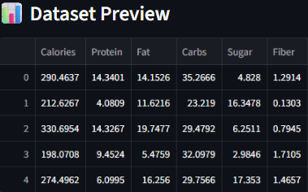



Dataset & Preprocessing
Dataset Characteristics
Data Cleaning
Synthetic nutrition dataset containing 6,278 records across multiple food categories with comprehensive nutritional attributes.
Removed duplicates to eliminate bias. Missing values filled using median for numerical features and mode for categorical variables.
Encoding
Label Encoding applied to target variable for model compatibility
Scaling
StandardScaler normalised features to unit variance
Balancing
SMOTE resolved class imbalance effectively

Slide 5
Exploratory Data Analysis – Key Insights
Imbalanced Distribution
Strong Correlations
Discriminative Features
Class distribution showed significant imbalance, necessitating SMOTE for synthetic sample generation and balanced training.
Calories and Carbohydrates exhibited strong positive correlation, revealing key nutritional relationships within food categories.
Protein and Sugar content emerged as powerful features for distinguishing between different food categories.
Visualisation Techniques
Class distribution plots revealing imbalance patterns
Correlation heatmap showing feature relationships
Boxplots for outlier detection and treatment

Slide 6
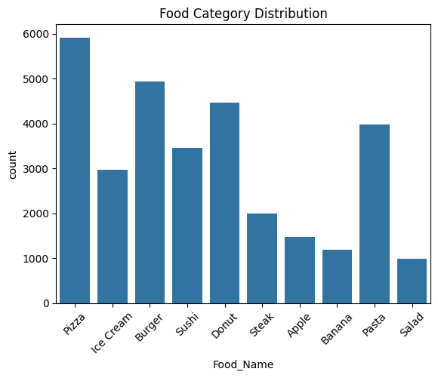

Slide 7
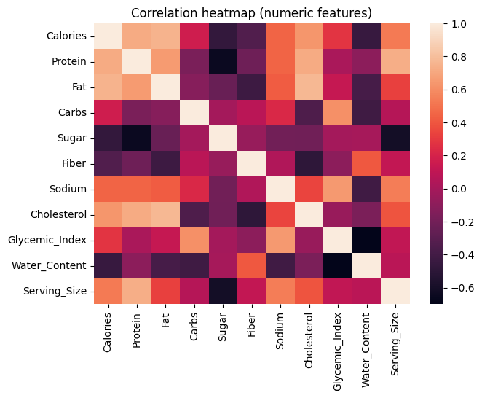

Slide 8
Modelling Approach
Algorithms Evaluated
Training Strategy
Logistic Regression
Data Split
Linear baseline classifier
80% training, 20% testing with stratified sampling
K-Nearest Neighbours (KNN)
Cross-Validation
Instance-based learning algorithm
3-5 fold stratified CV for robust evaluation
Support Vector Machine (SVM)
Pipeline Design
Maximum margin classifier
Integrated scaling, SMOTE, and model training
Decision Tree
Reproducibility
Rule-based classification
Fixed random seed ensures consistent results
Random Forest
Ensemble of decision trees
Gradient Boosting
Sequential ensemble method
XGBoost
Optimised gradient boosting

Slide 9

Model Evaluation Results
Comprehensive performance comparison across seven machine learning algorithms with multiple evaluation metrics
Model
Accuracy
Macro F1
Precision
Recall
CV Macro F1
KNN
99.16%
99.23%
99.29%
99.18%
98.88%
SVM
99.35%
98.96%
98.60%
99.38%
98.70%
XGBoost
99.33%
98.92%
98.57%
99.33%
98.68%
Random Forest
99.27%
98.89%
98.53%
99.30%
98.68%
Gradient Boosting
99.28%
98.85%
98.49%
99.27%
98.64%
Logistic Regression
99.00%
98.67%
98.60%
98.75%
98.61%
Decision Tree
98.66%
98.38%
98.02%
98.79%
98.13%
Best Model: K-Nearest Neighbours (KNN) — Achieved highest Macro F1 score of 99.23% with exceptional balance across all performance metrics, demonstrating superior classification capability.

Slide 10
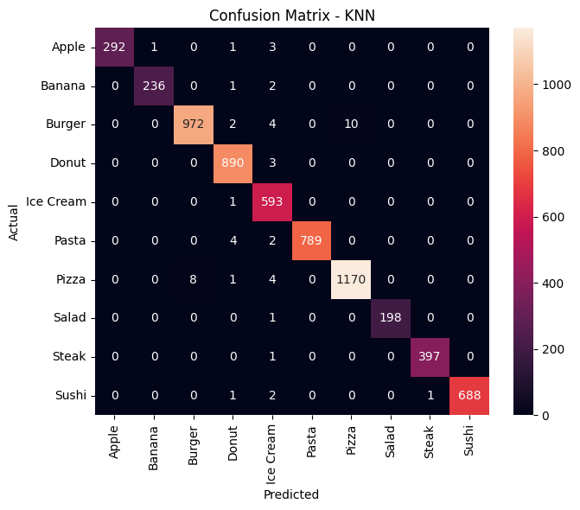

Slide 11
Key Project Features
Cloud-Based Development
Robust Pipeline
Comprehensive Comparison
Visual Insights
Clean, structured preprocessing pipeline integrating scaling, encoding, and SMOTE for optimal data preparation
Rich visualisations included throughout for enhanced understanding of data patterns and model behaviour
Complete ML workflow built entirely in Google Colab, enabling seamless collaboration and accessibility
Seven algorithms trained and evaluated using proper metrics for thorough performance assessment
Version Control
Complete codebase and results maintained in GitHub for reproducibility and collaboration

Slide 12
Challenges & Solutions
1
Imbalanced Classes
Challenge: Uneven distribution across food categories risking biased predictions
Solution: Implemented SMOTE to generate synthetic samples and achieve balanced training data
2
Model Selection
Challenge: Identifying the optimal algorithm from multiple candidates
Solution: Systematic comparison using macro-averaged metrics for fair evaluation
3
Data Quality
Challenge: Handling outliers and missing values that could compromise model performance
Solution: Applied IQR method for outliers and statistical imputation for missing data
4
Code Structure
Challenge: Maintaining clean, reusable code throughout development
Solution: Followed modular pipeline architecture in Colab for maintainability

Slide 13
Future Improvements & Next Steps
Real-World Data Integration
1
Incorporate actual food nutrition databases for stronger generalisation and practical applicability
Deep Learning Exploration
2
Experiment with neural networks and deep learning architectures for potentially improved performance
Advanced Feature Engineering
3
Create derived features and interaction terms to capture complex nutritional relationships
Pipeline Automation
4
Develop automated workflow for easier deployment, reuse, and production integration
Thank You!
Questions are welcome.

